Slide 1






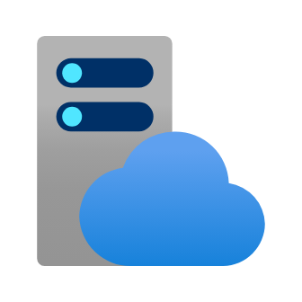




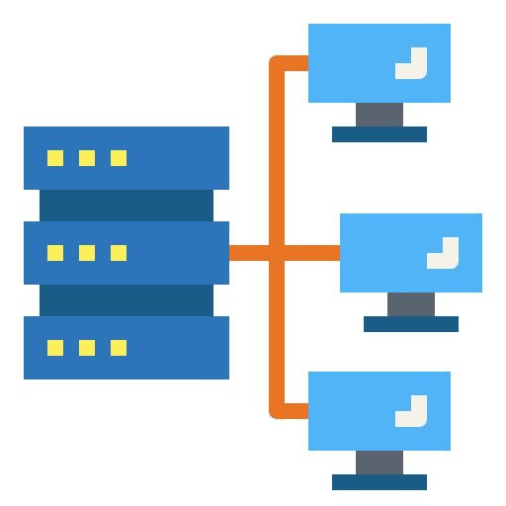



Web Hook
Repository Upload
Worker 1
Worker 2
Load Balancer
Code Upload
Monitoring
User
User
Developer
Web
Web

